Slide 1
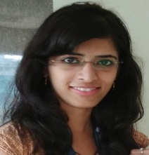
Keerthi Hegde
Main Focus
Primary Skills:
RPA using UIPath
Core and Advanced Java, R Programming
Secondary Skills:
AngularJS, Bootstrap, Angular2
Industries worked for:
Healthcare
Capgemini Internal
Keerthi Hegde
+91-8217804278
Keerthi.hegde@capgemini.com
Profile Summary
A Brief Summary of Experience
UiPath Foundation Level Certified Developer
Certified Automation Engineer Level I
Competent on working in challenging tasks
Hands On:
Worked on automating various use cases for GE Healthcare
Worked on automation of time card application.
Involved in training people on UIPath
Tools used :
UIPath– Robotic process automation tool.
Automation : Automated applications like
Solving missing software requests
Solving Software Download Issues
Solving Cancellation of requests
Automation of time card application
Requirements and Analysis : Understanding the requirements of the client as well as getting it documented and act as a functional/technical resource.

